Slide 1


Slide 2
PART-I Getting Comfortable With The Data Structure
Q1.1) How many Pageviews did Glamour have in August?
Q1.2) How many people saw a video on CNT?
Q1.3)What percentage of SELF’s sessions are bounces. Which device type has the highest bounce rate?

Slide 3
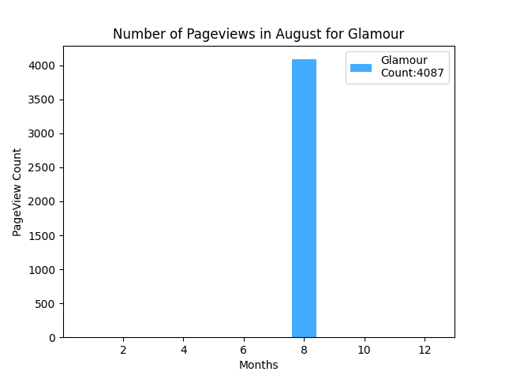
Q1.1) How many pageviews did Glamour have in August?

Slide 4
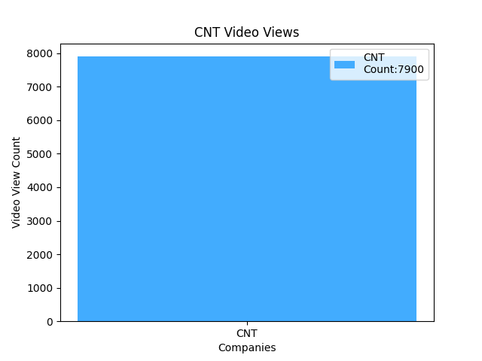
Q1.2) How many people saw a video on CNT?

Slide 5
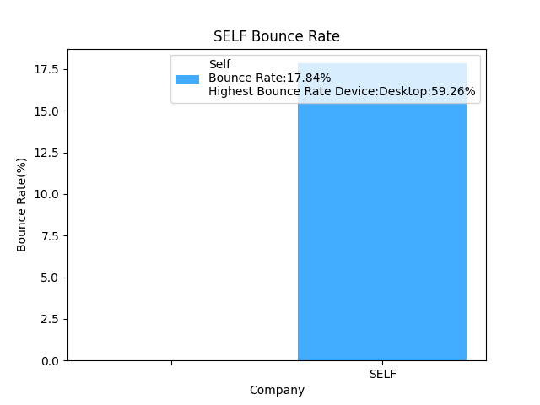
Q1.3) What percentage of SELF’s sessions are bounces. Which device type has the highest bounce rate?

Slide 6
PART-II User Behavior
CNT exists in multiple markets. Our stakeholders are curious which market's subscription order form is the best. Find the subscription rate for each of CNT's markets.What might you say to a stakeholder to contextualize these results?
Glamour launched a new marketing strategy on 09/01/2020 with more personalized ads. Compare the click through rate for Ads on Glamour before and after the change in strategy. Did it increase the CTR? What other insights can you find about the new strategy?
A product manager is interested in brand loyalty. Please create a monthly cohort retention graph for Pitchfork.

Slide 7
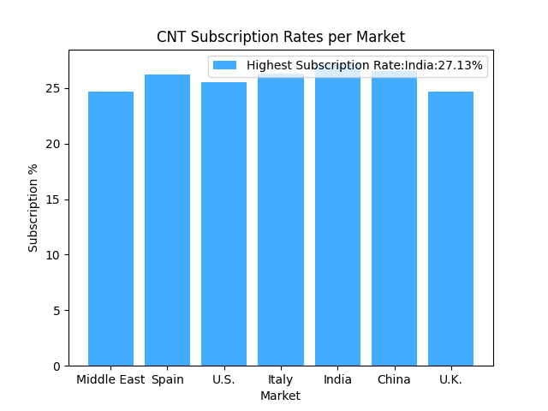
Q2.1) Find the subscription rate for each of CNT's markets.What might you say to a stakeholder to contextualize these results?

Slide 8
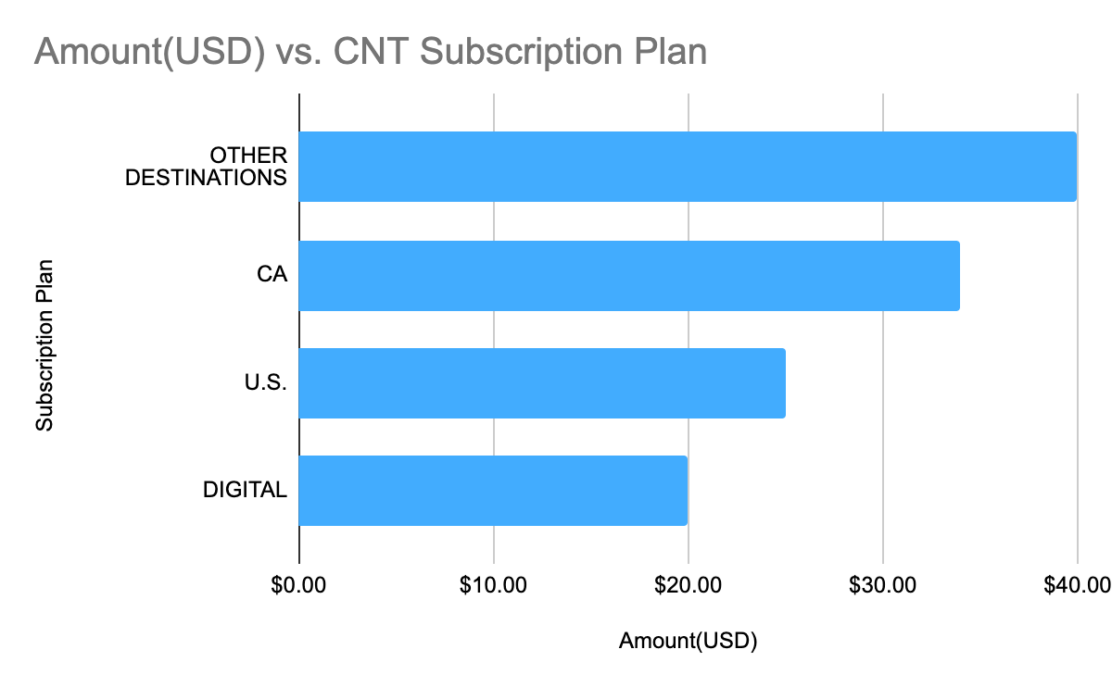
Q2.1) What might you say to a stakeholder to contextualize these results? If we take a look at the subscription plan we can calculate a revenue estimate per market.

Slide 9
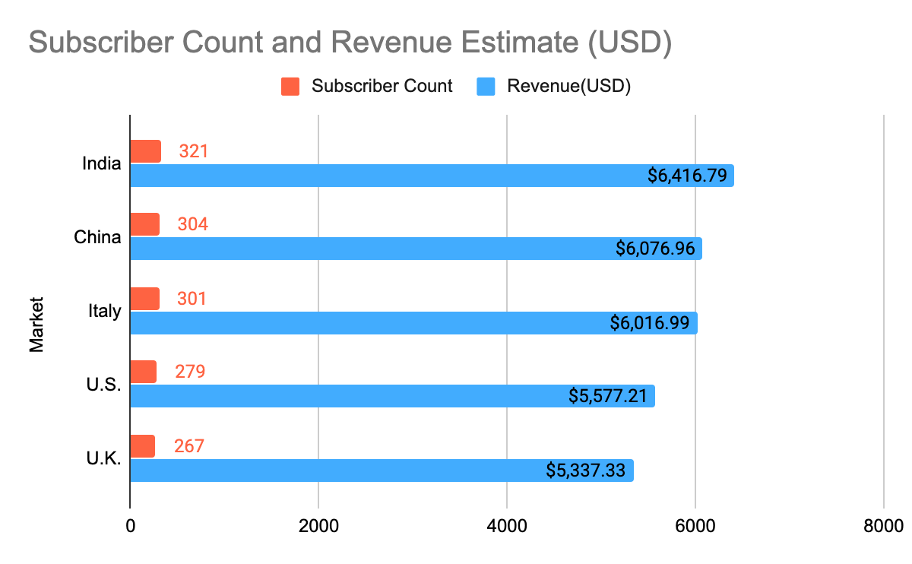
Q2.1) What might you say to a stakeholder to contextualize these results?
Based off of the lowest amount:$19.99 as our baseline, here is our worst case scenario revenue estimates

Slide 10
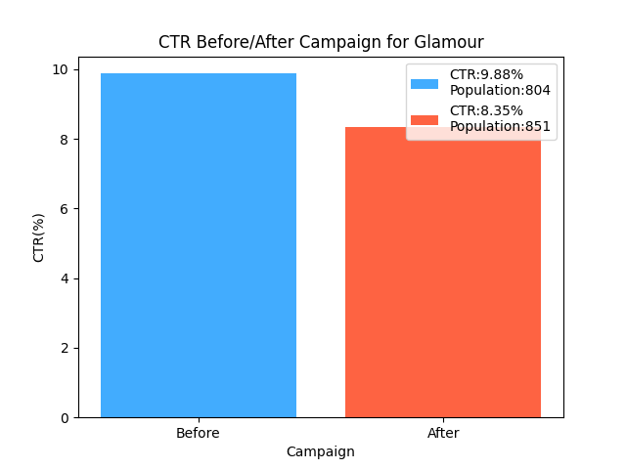
Q2.2) Compare the click through rate for Ads on Glamour before and after the change in strategy.
Overall CTR trend is declining seen in figure. Let’s see how CTR performance on our Loyal Customers in the next slide

Slide 11
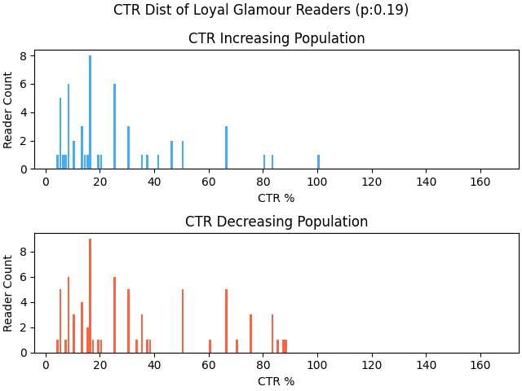
Q2.2) Compare the click through rate for Ads on Glamour before and after the change in strategy.
CTR% of our loyal readers has declined by 6.25% on average. But looking at the before and after campaign CTR% distributions’ p-value;we can acknowledge that the campaign is had no significant effect for our loyal customers.

Slide 12
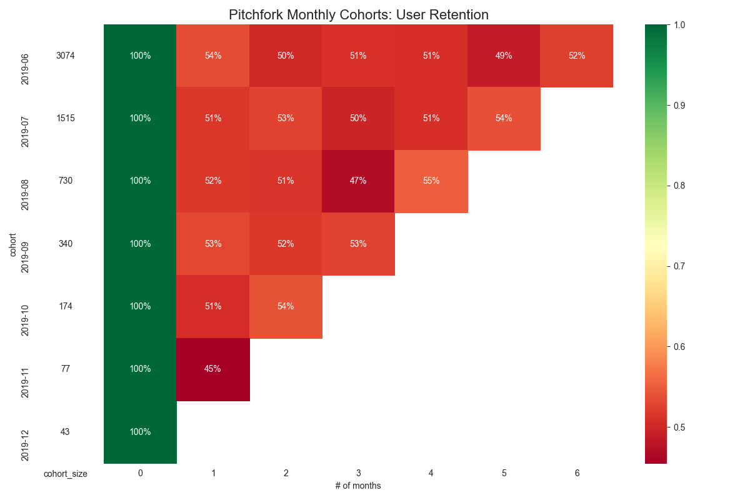
Q2.3) A product manager is interested in brand loyalty. Please create a monthly cohort retention graph for Pitchfork.

Slide 13
PART-III Data Exploration
I will try to find a trend in the advertisement clicks for the Brand:Conde Nast Traveler…

Slide 14
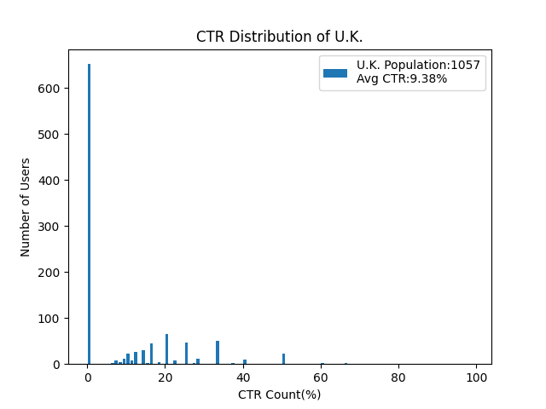
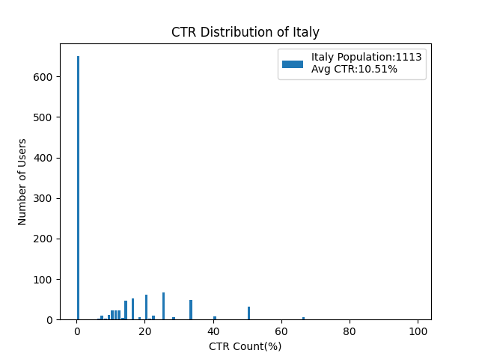
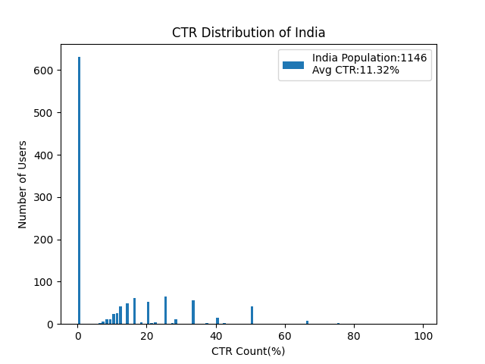
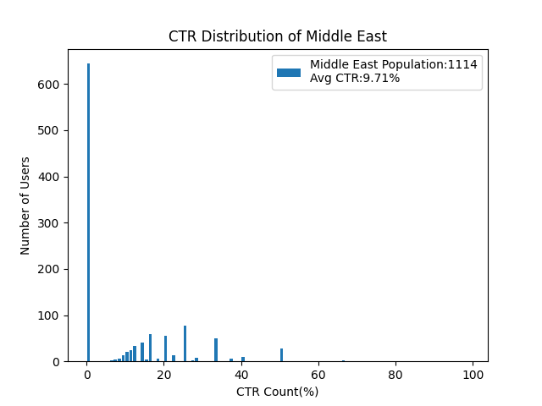
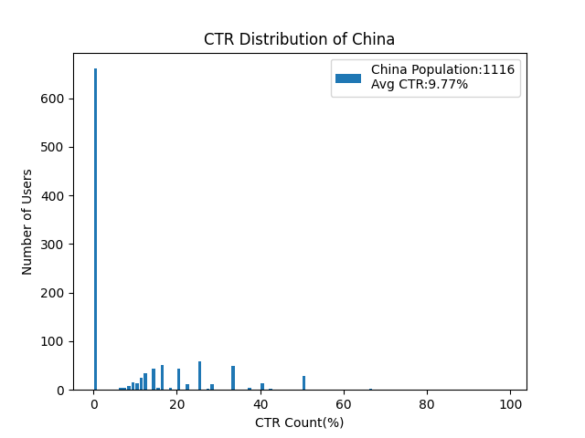
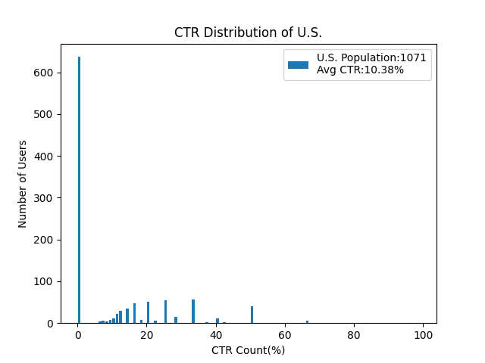
Q3) CTR% PERFORMANCE INVESTIGATION OF CNT/MARKET
OUTLIERS

Slide 15
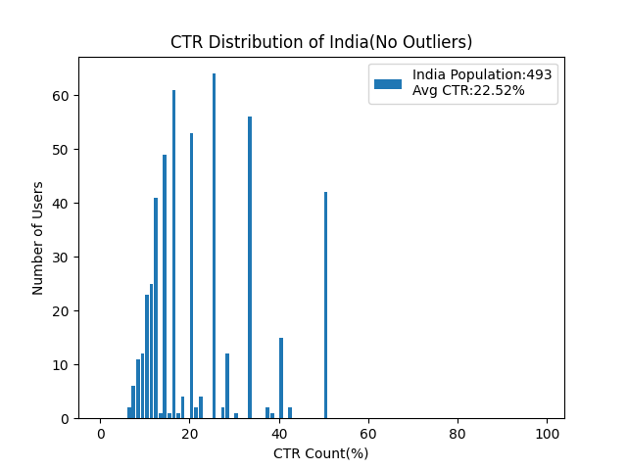
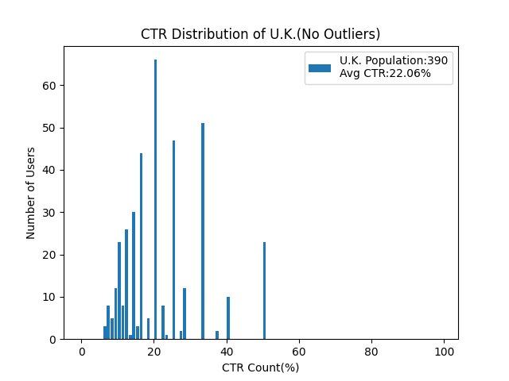
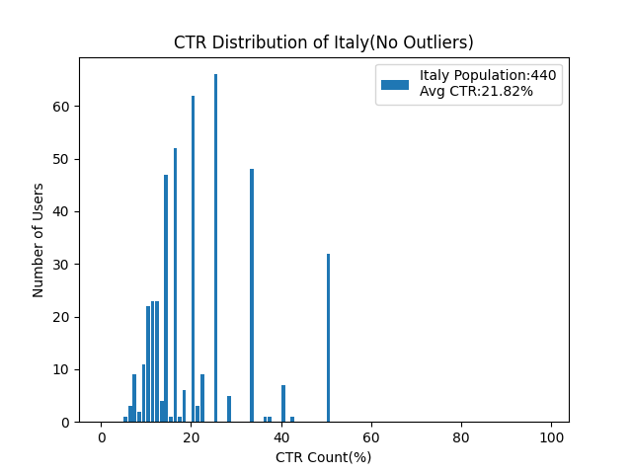
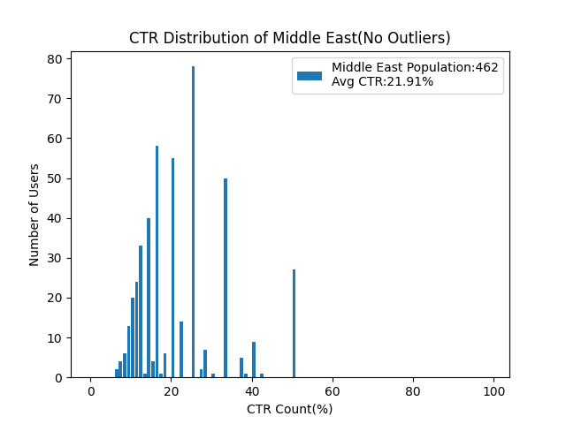
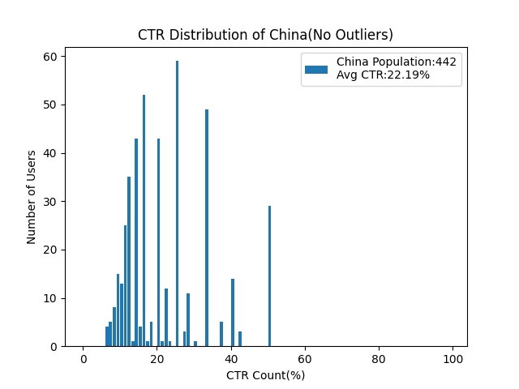
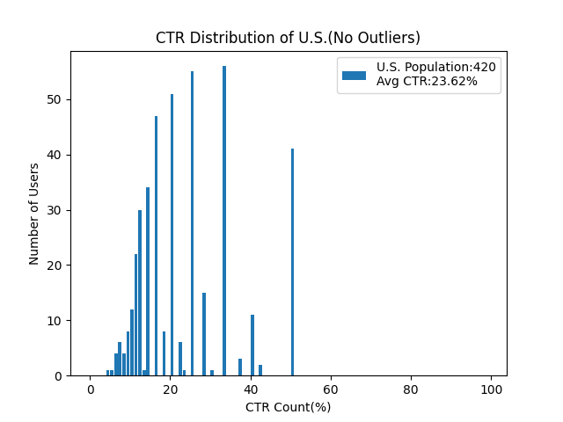
Q3) CTR% PERFORMANCE INVESTIGATION OF CNT/MARKET
NUMBER OF OUTLIERS TAKEN OUT: 4647
p-value:0.22

Slide 16
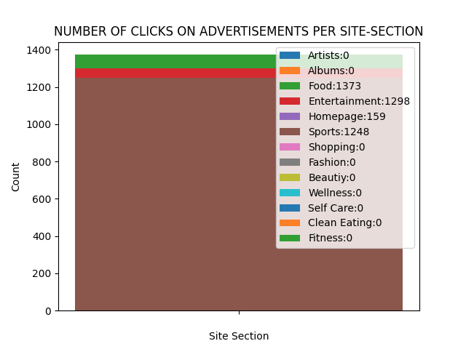
Q3) SITE SECTION: FOOD, ENTERTAINMENT & SPORTS GETS THE MOST ADVERTISEMENT CLICKS AMONGST OUR AVERAGE READERS

Slide 17
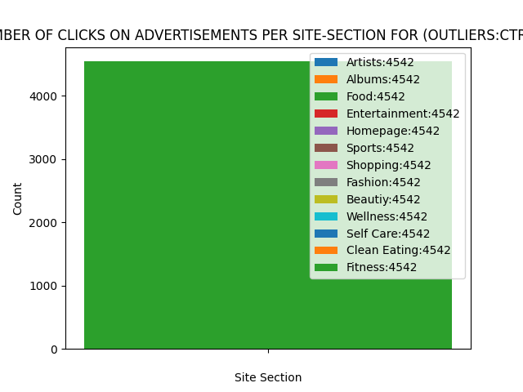
Q3) SITE SECTION: REMEMBER THOSE OUTLIERS WITH CTR<1%...4647 of THEM… THEY WERE CLICKING TO ADS ON EVERY SITE SECTION EQUALLY!!

Slide 18
PART-III FINDINGS
CNT is active in all markets: Middle East, Spain, U.S., Italy, India, China, U.K.
Average reader count of 949 per market, number of readers per market do not differ significantly from each other. This means we have similar size of audience reach per market.
FOOD, ENTERTAINMENT & SPORTS are the top 3 sections that gets the most advertisement clicks amongst our average readers.
The number of outliers is very high at:4647 out of 7705 readers… Wanted to see which site gets the most advertisement clicks amongst outliers to understand their behaviour and evaluate a prospective pattern…
It turns out, outliers do NOT click to advertisement equally no matter which site section they are in.

Slide 19
SUGGESTIONS
Potential CTR% increase paths:
Increase CTR of outliers in every site-section:
Send them a survey to understand which site-section is their favorite,
Start a targeted campaign for outlier users in their favorite section
Increase CTR for our average readers in the other site-sections:
This is slightly more challenging since the reason they are not clicking on other sections is unclear with the given data. They simply may not be interested in those site-sections, unless there was a campaign that ran specifically on those sections for some people. That might have caused an increase in their CTR%... If that’s the case then I would compare CTR behavior of these users before and after the campaign to find a pattern and launch a similar campaign for my outlier users.

Slide 20
Glossary
Video views with impression events
“bounce” as a session with only one pageview.
Subscription rate as subscriptions/unique users
Click through rate as clicks/impressions

